Slide 1
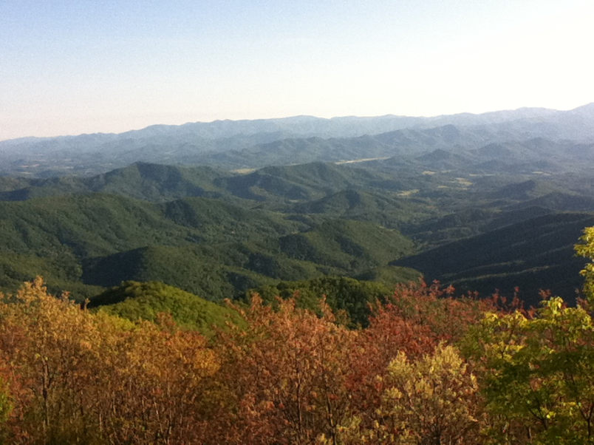



Constraining hillslope sediment flux using high resolution topographic data
Stuart Grieve, Simon Mudd & Martin Hurst

Slide 2
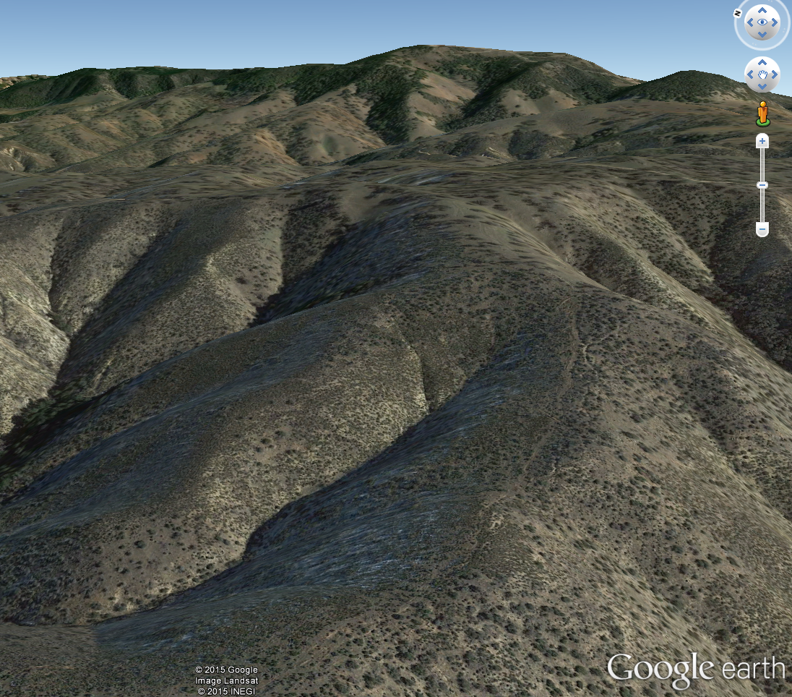
What is hillslope sediment flux?
Volume of sediment transported on a hillslope per unit area in a period of time
Integral in landscape evolution modelling
Sediment flux controls:
Geometry of hillslopes
Landscape response to climate and tectonic forcing

Slide 3
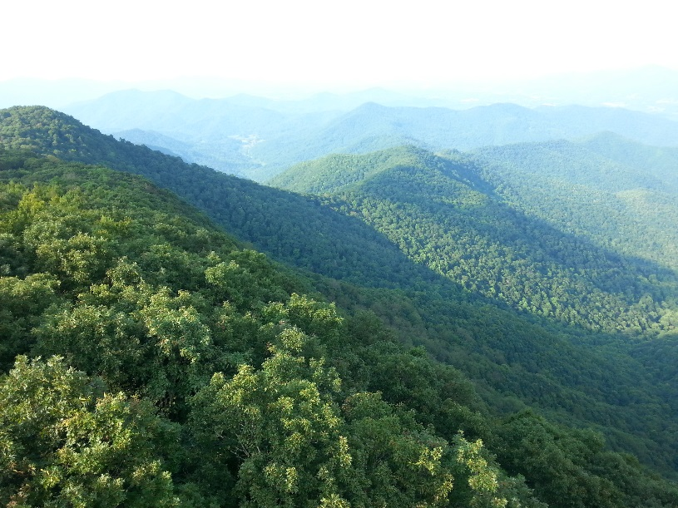
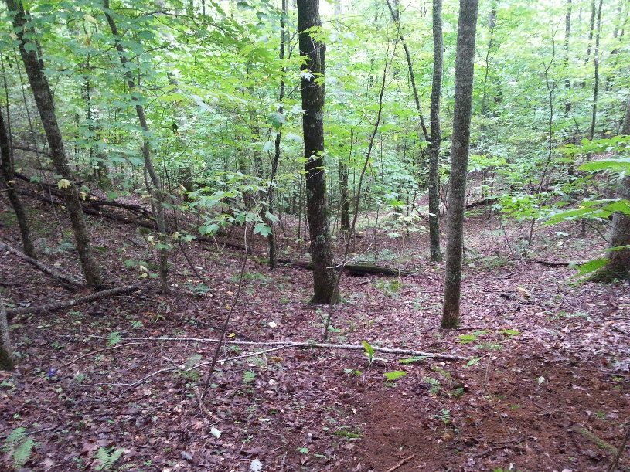
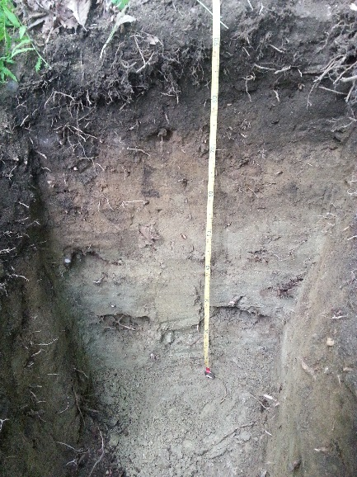
What is hillslope sediment flux?
Creep dominated landscapes
High infiltration capacity

Slide 4
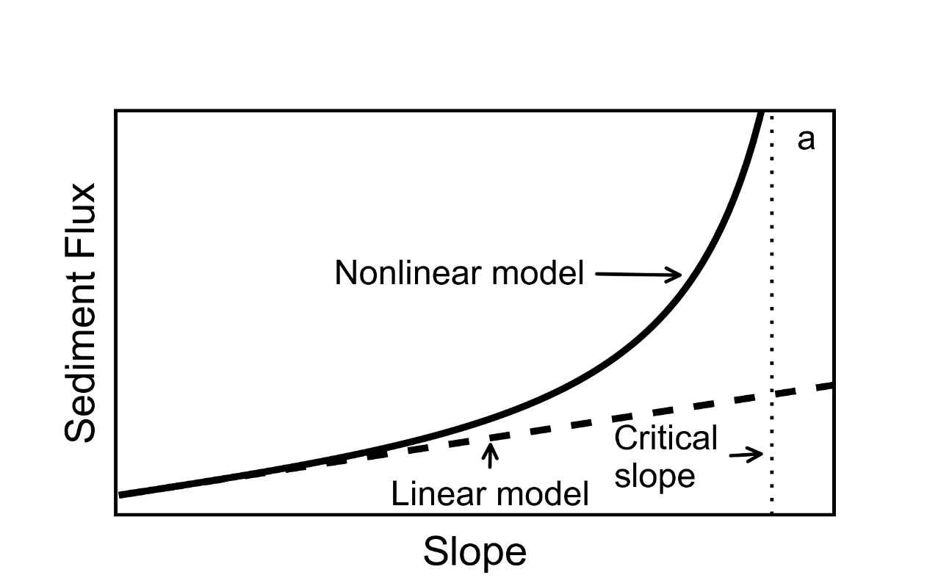
What is hillslope sediment flux?
Two end-member models of sediment flux:

Slide 5
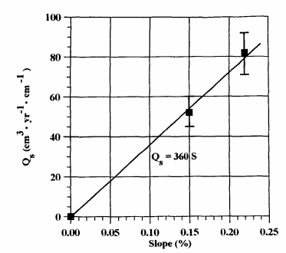
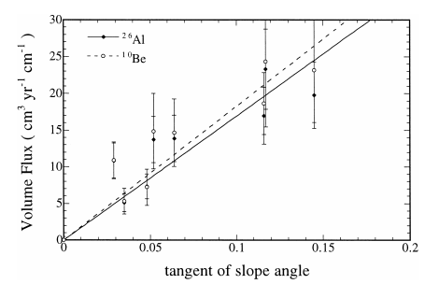
Constraining linear flux
Mckean (1993)
Small (1999)
Cosmogenic radionuclides

Slide 6
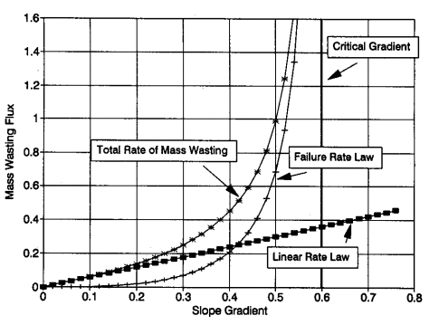
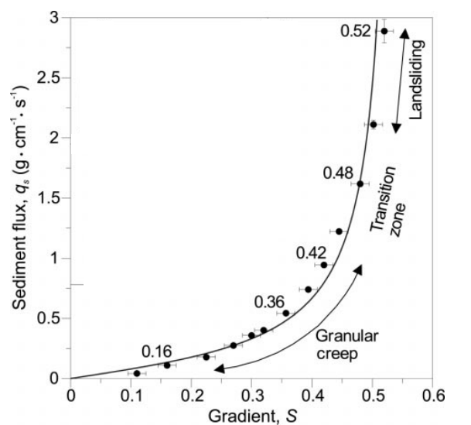
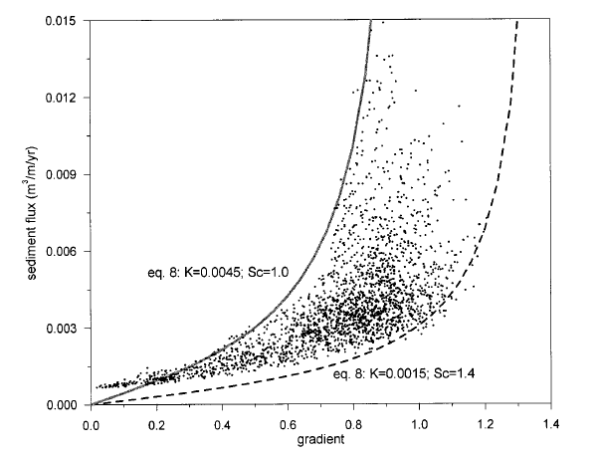
Constraining nonlinear flux
Howard (1994)
Basin modelling
Roering (1999,2001)
CRN & basin measurements
Analogue hillslopes

Slide 7
Constraining sediment flux
Limited to local scale
Can we constrain hillslope sediment flux at a landscape scale?
Both models make predictions about relief structure of landscapes

Slide 8

Predicted relief structure

Slide 9
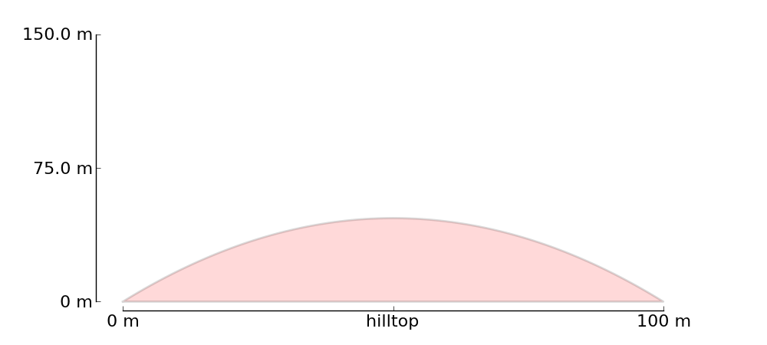
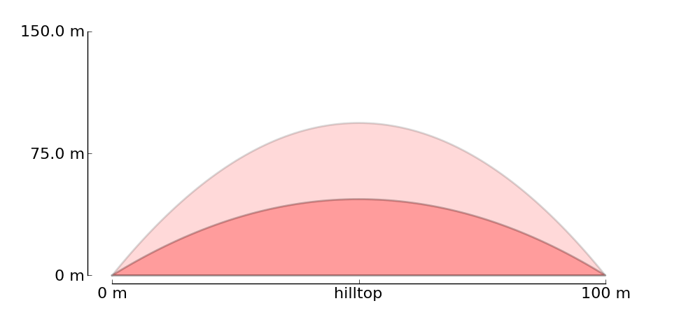
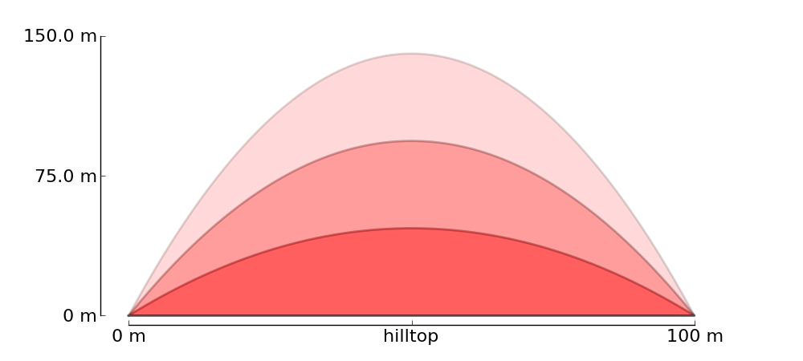
Predicted relief structure: Linear
Steady state hillslope
Uplifted at 0.1, 0.2 & 0.3 mm/yr

Slide 10
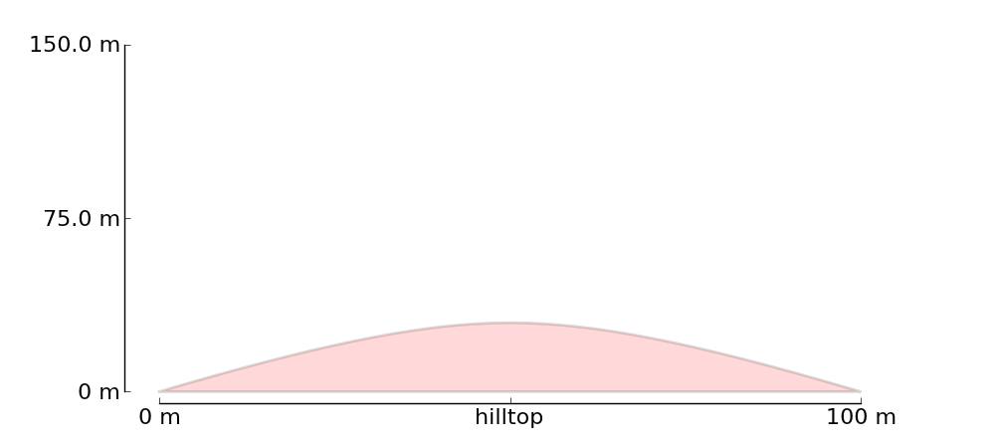
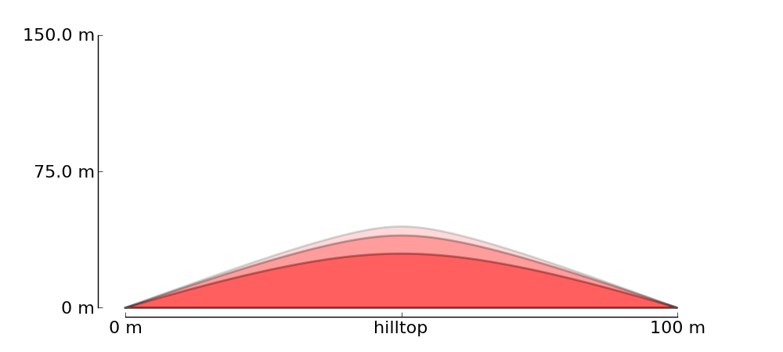
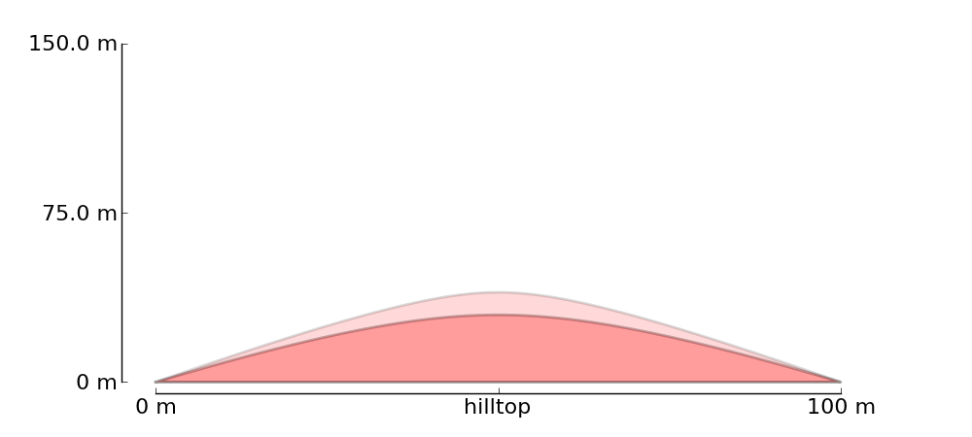
Predicted relief structure: Nonlinear
Steady state hillslope
Uplifted at 0.1, 0.2 & 0.3 mm/yr

Slide 11
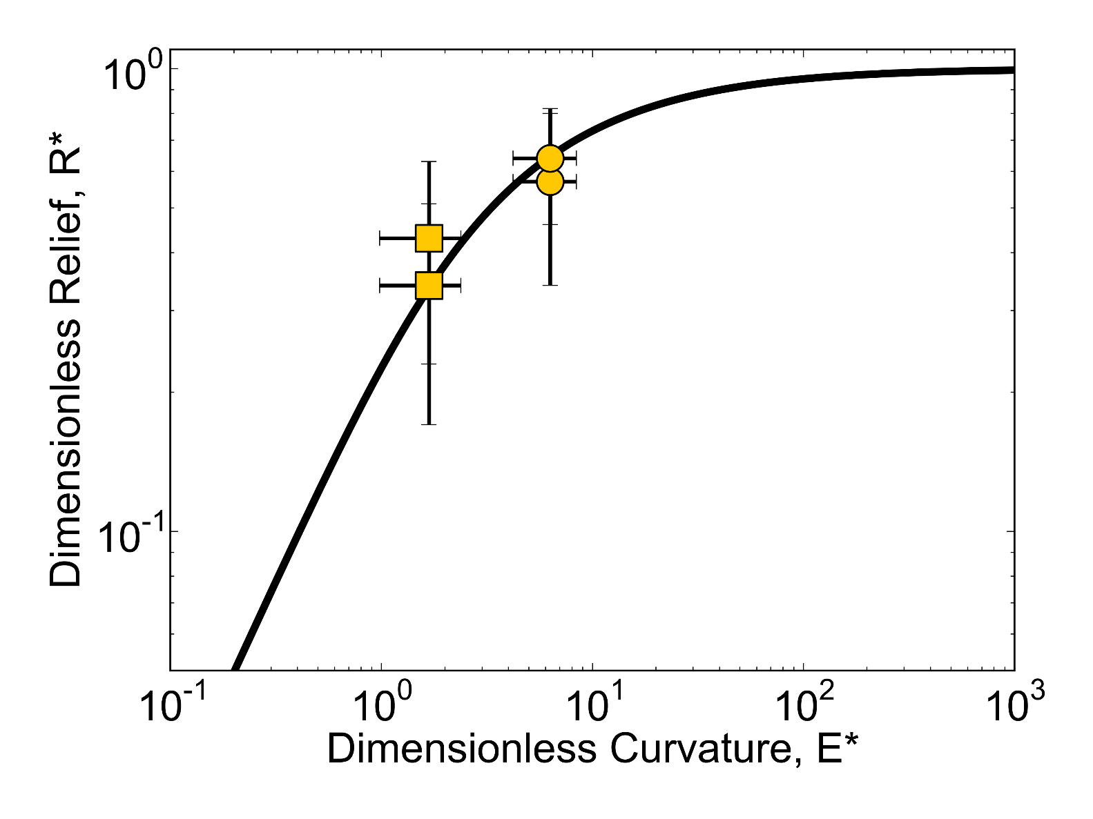
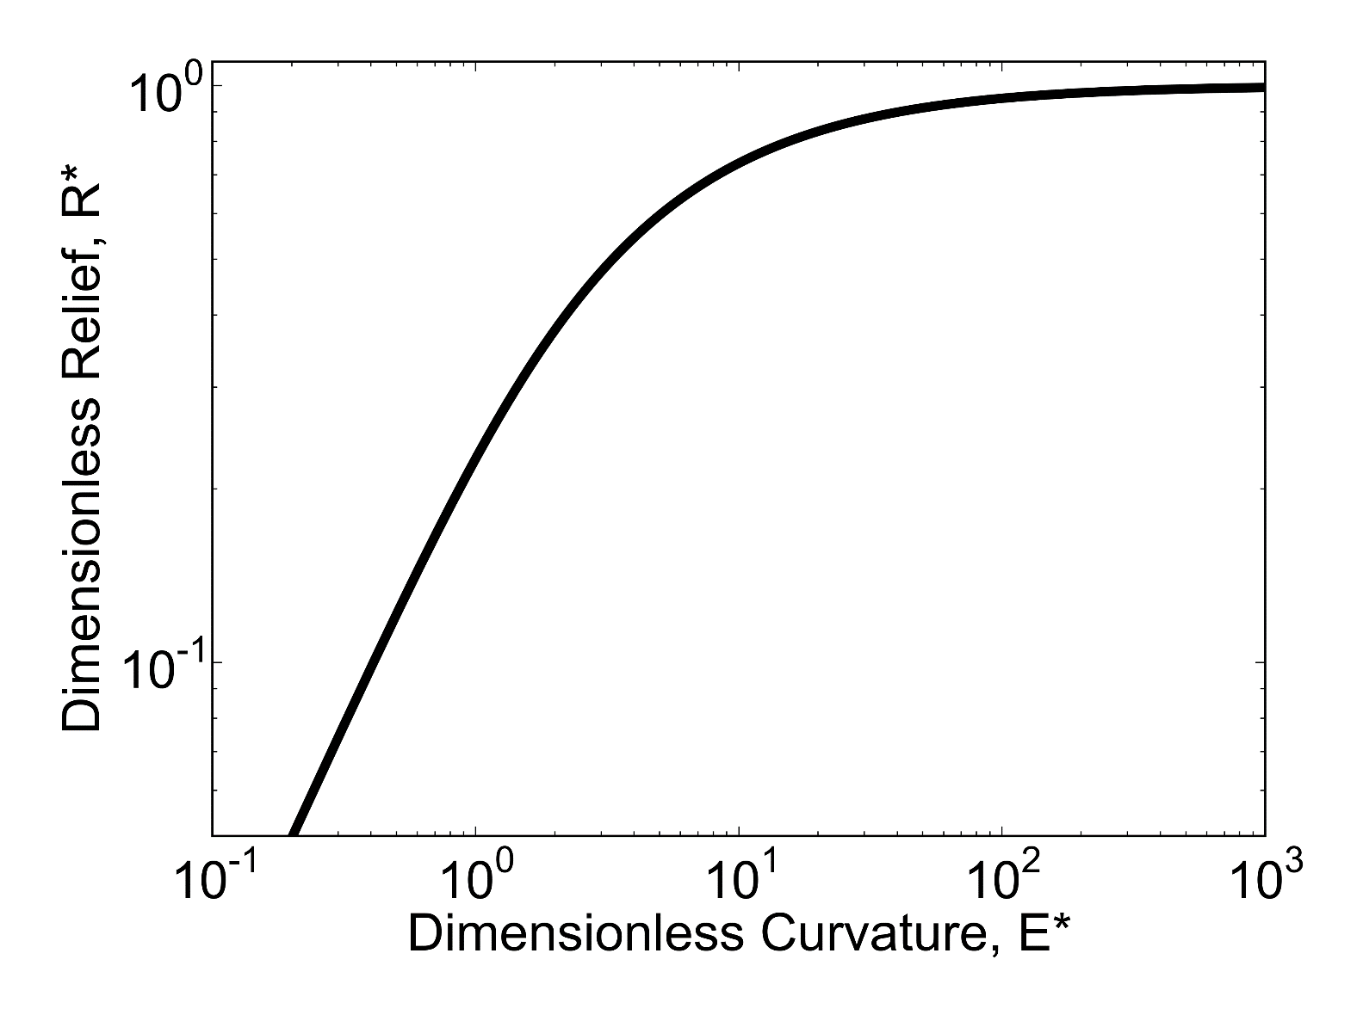
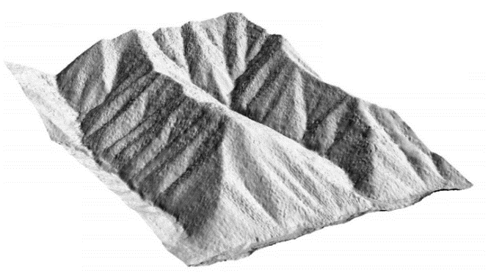
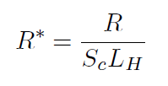
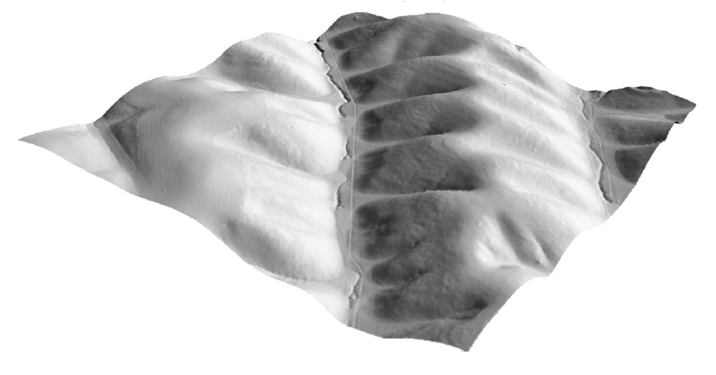
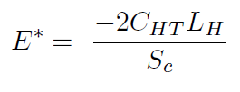
Dimensionless relief and curvature
Oregon Coast Range
Gabilan Mesa

Slide 12
Topographic analysis
Challenge is to move beyond basin scale
We need to measure some parameters continuously across our landscapes:
Hillslope length
Relief
Hilltop curvature

Slide 13
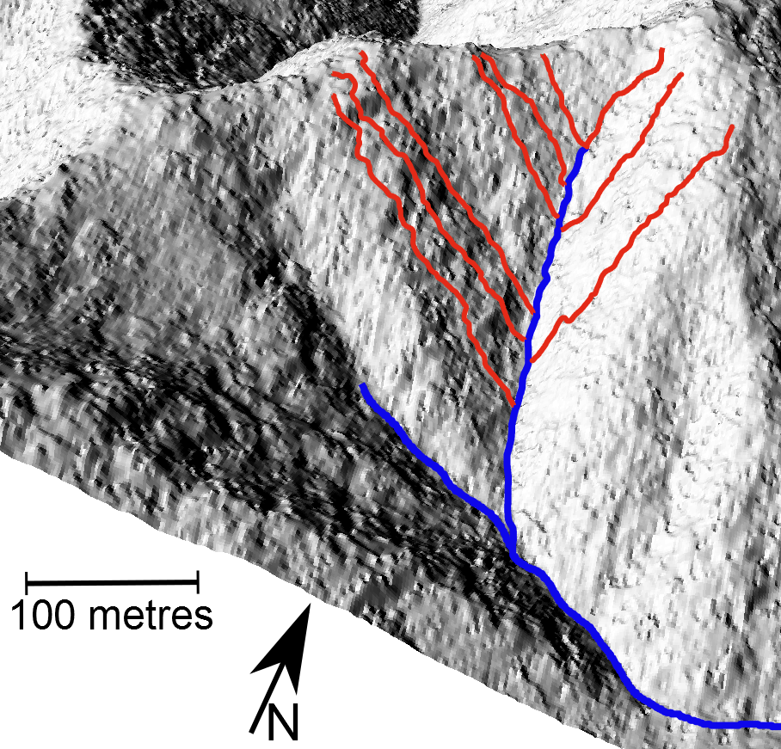
Connecting hillslopes to channels
Model sediment flow from hilltop to channel
Couples every hillslope to it’s channel

Slide 14
Measuring hillslopes directly
Don’t use steepest descent
Model flow within each pixel
Gives a more realistic flow path on hillslopes
100
150
20
280
170
70
350
120
90

Slide 15
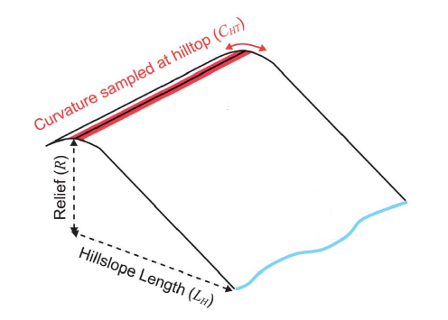
Relief and hilltop curvature

Slide 16
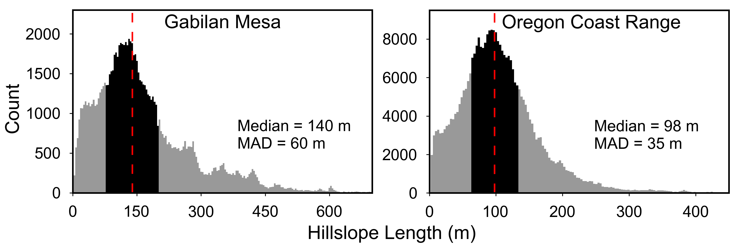
Measuring hillslopes directly
We have continuous measurements of these values across our landscapes
72 m
57 m

Slide 17
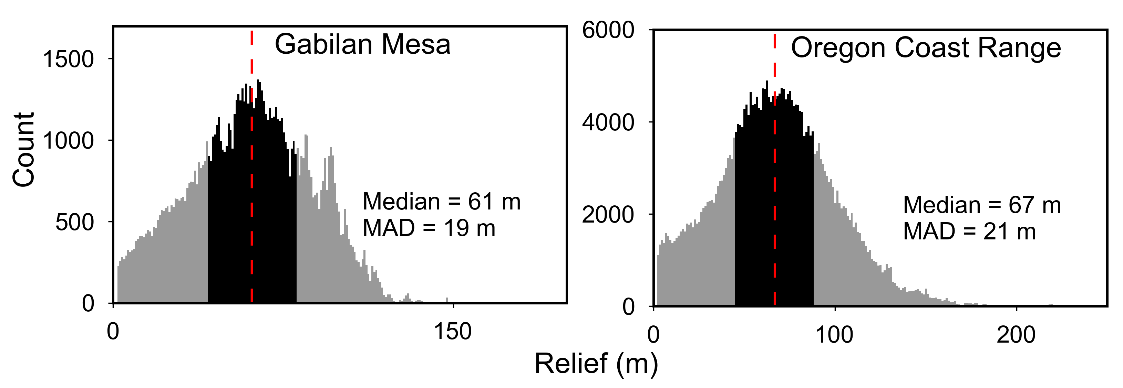
Measuring hillslopes directly
37 m
39 m

Slide 18
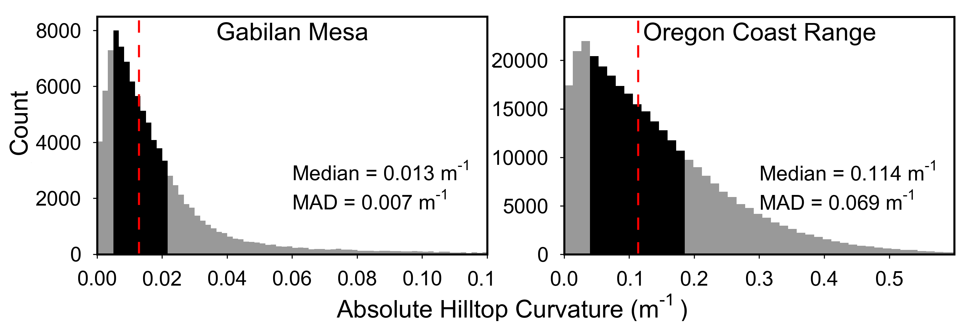
Measuring hillslopes directly
0.014 m⁻¹
0.07 m⁻¹

Slide 19
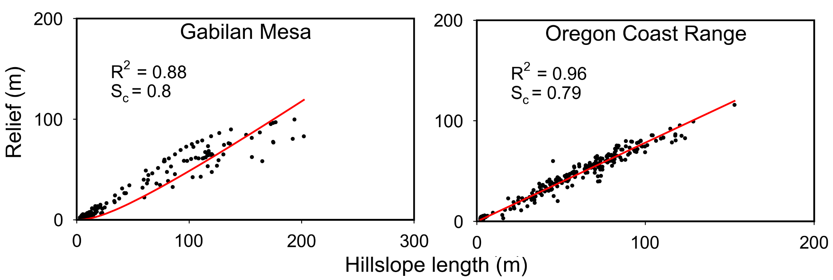
Hillslope length-relief relationships
Notes:
Must filter the data to only keep non divergent hillslopes
Explain that the fit is not a best fit line, but the best model fit

Slide 20
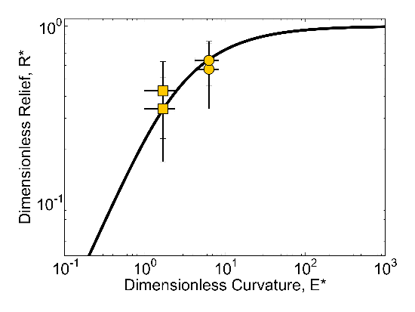
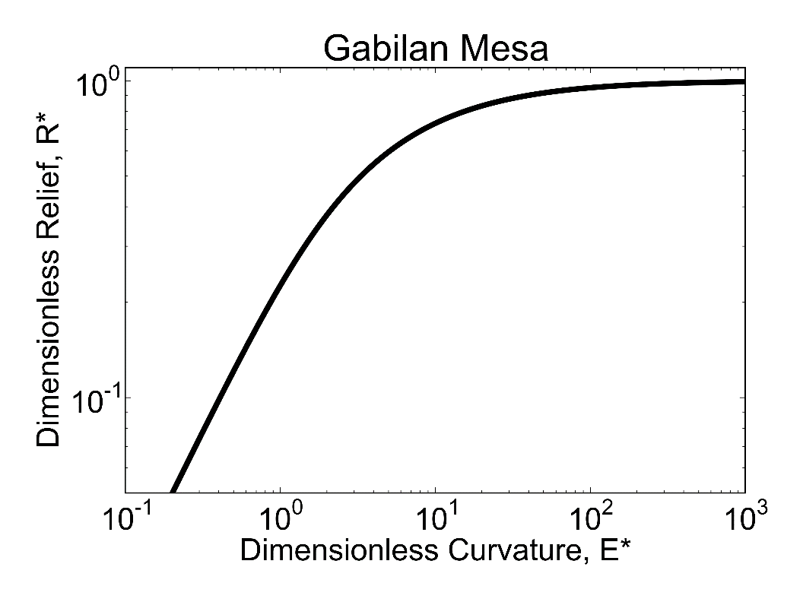
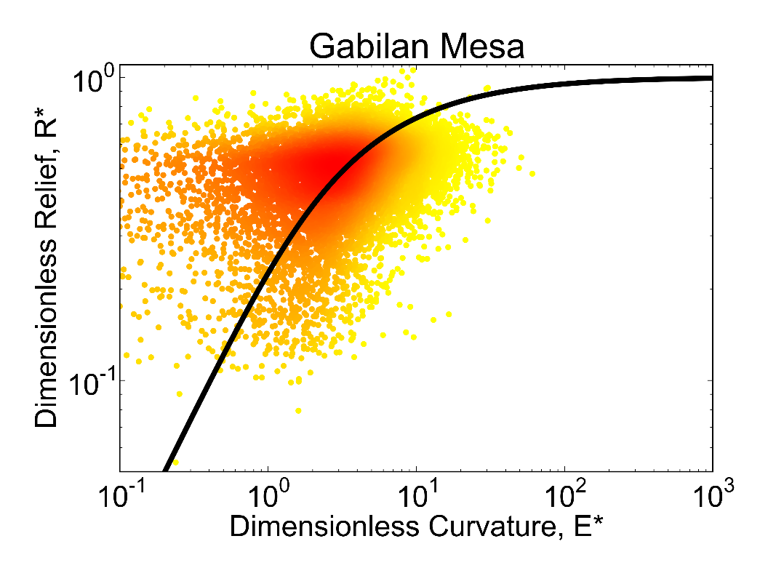

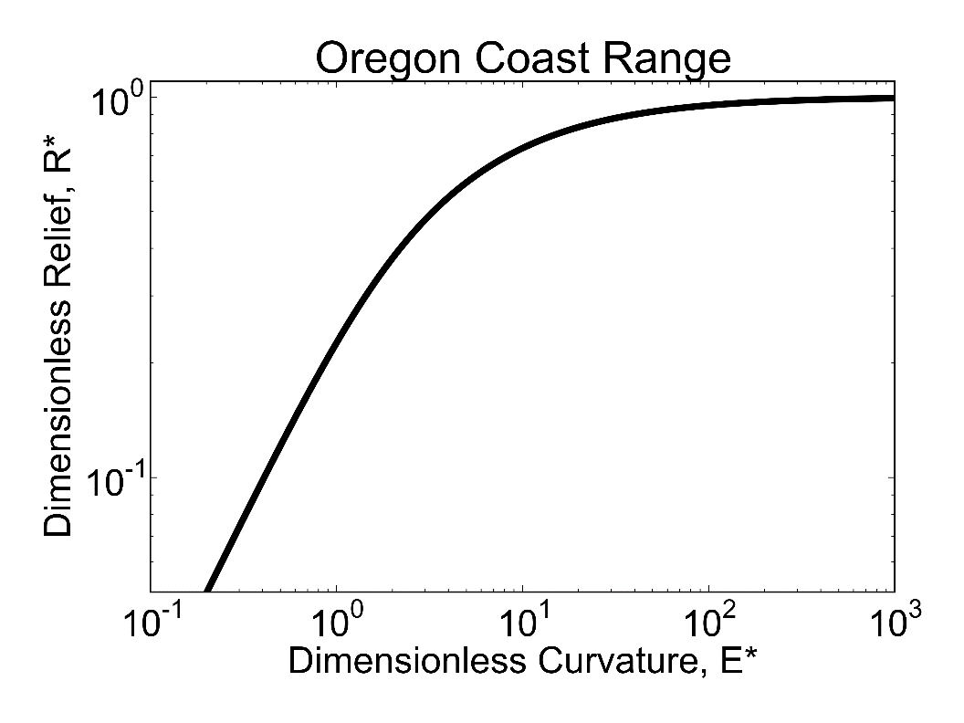
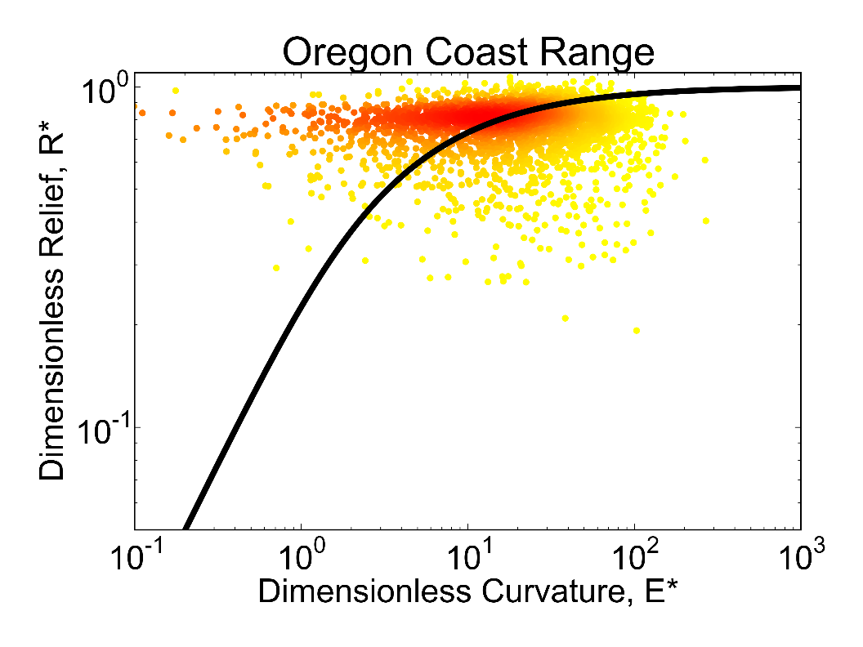

Dimensionless relief and curvature
Notes:
Animate to remove density of points below a threshold – eg 80% of hillslope traces are in the highlighted region, around the steady state curve. Also able to add in the median data point and explain that the error bars are within the point.

Slide 21
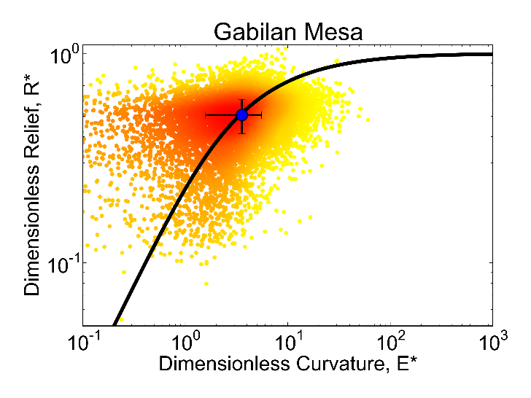
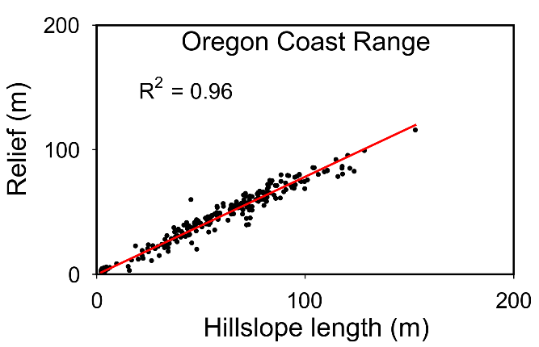
Conclusions
Strong evidence for nonlinear sediment flux at a landscape scale
Dimensionless parameters show more variation than expected for steady state landscapes

Slide 22
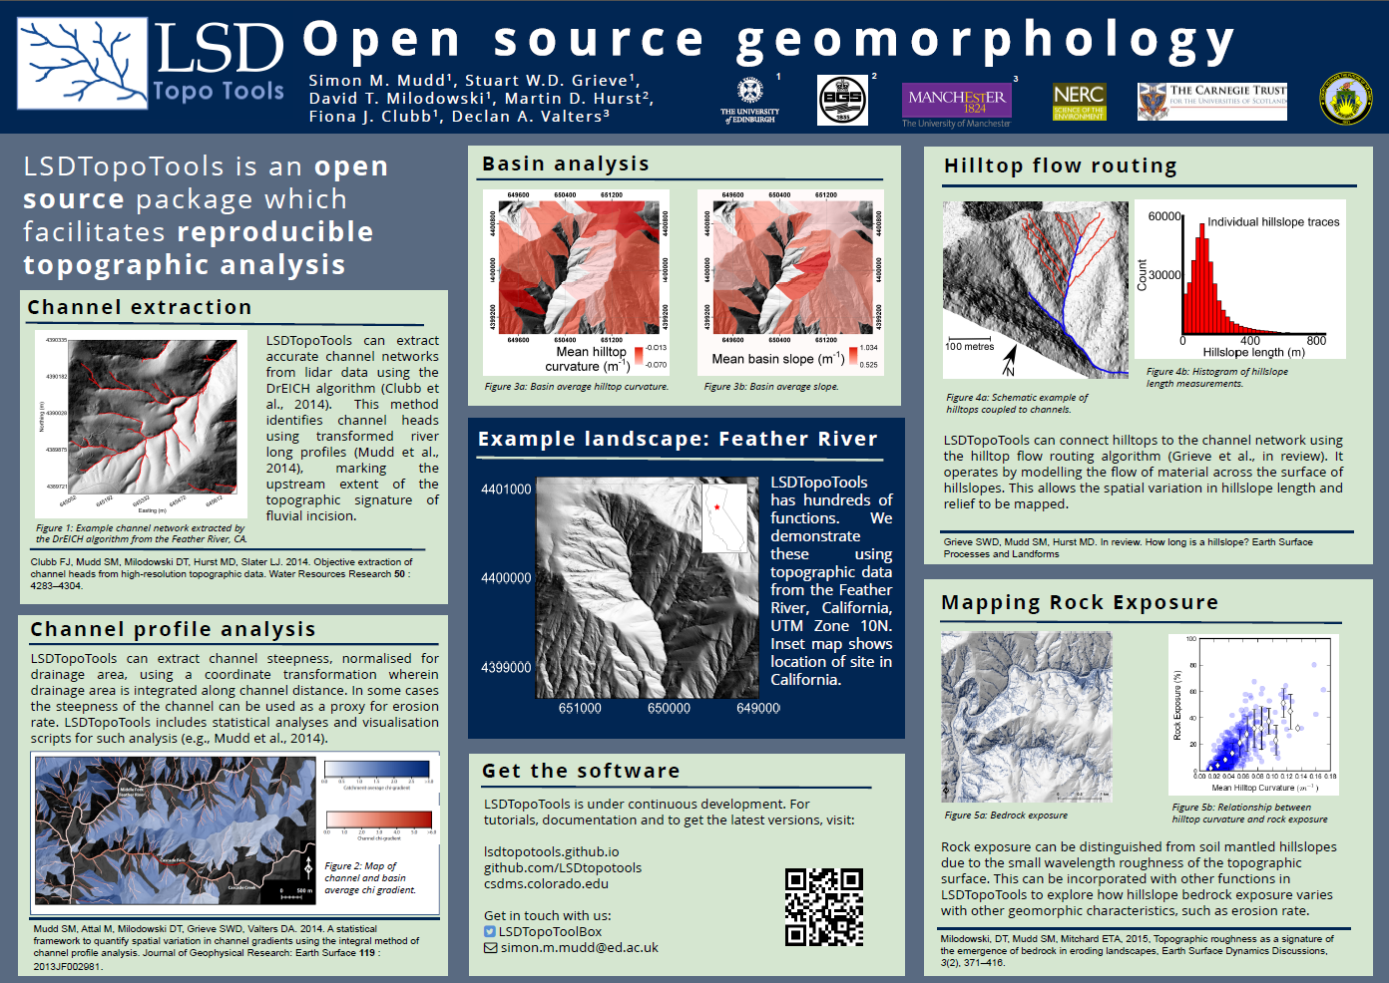
LSDTopoTools
Interested in trying this software out?
Poster P-S1

